Slide 1
USAF Academy Class of 1973
50th Reunion
Business Meeting
September 28, 2023

Slide 2
Introduction
Welcome & Overview
Ron Scott: Five-Year Review
Bob Munson: Class Gift Report & Legacy Gift Concept
Bill Diffley: 2023 Class Legacy Program
John Stefonik: Policies & Election of Officers
Passing the Gavel & Closing Remarks

Slide 3
Five-Year Review
Phantom Canyon opens its doors at 5:30 pm sharp
Parking Validation
Door Prizes . . . make sure you have a ticket
Thank you
Highlights: 2019-2023
Book Project

Slide 4
For 50th Reunion Class Approved Legacy Giving
Plan: By 2023 reunion
Spin up all classmates/spouses to have a will.
For classmates who wish to include the Academy as part of their estate plan, offer assistance
15% Polaris Society members….no dollar goal
Recommendation: Class of 1973 Long Blue Line Endowment
Notes:
One in three Americans over the age of 65 have no will. One in six Americans over the age of 65 have a Will that is out of date.
Thus, only half of Americans over the age of 65 have up-to-date Wills in place.
Wealthy Americans are no more likely to have written their Will.
Wealthy Americans are more likely to have an out-of-date Will.

Slide 5
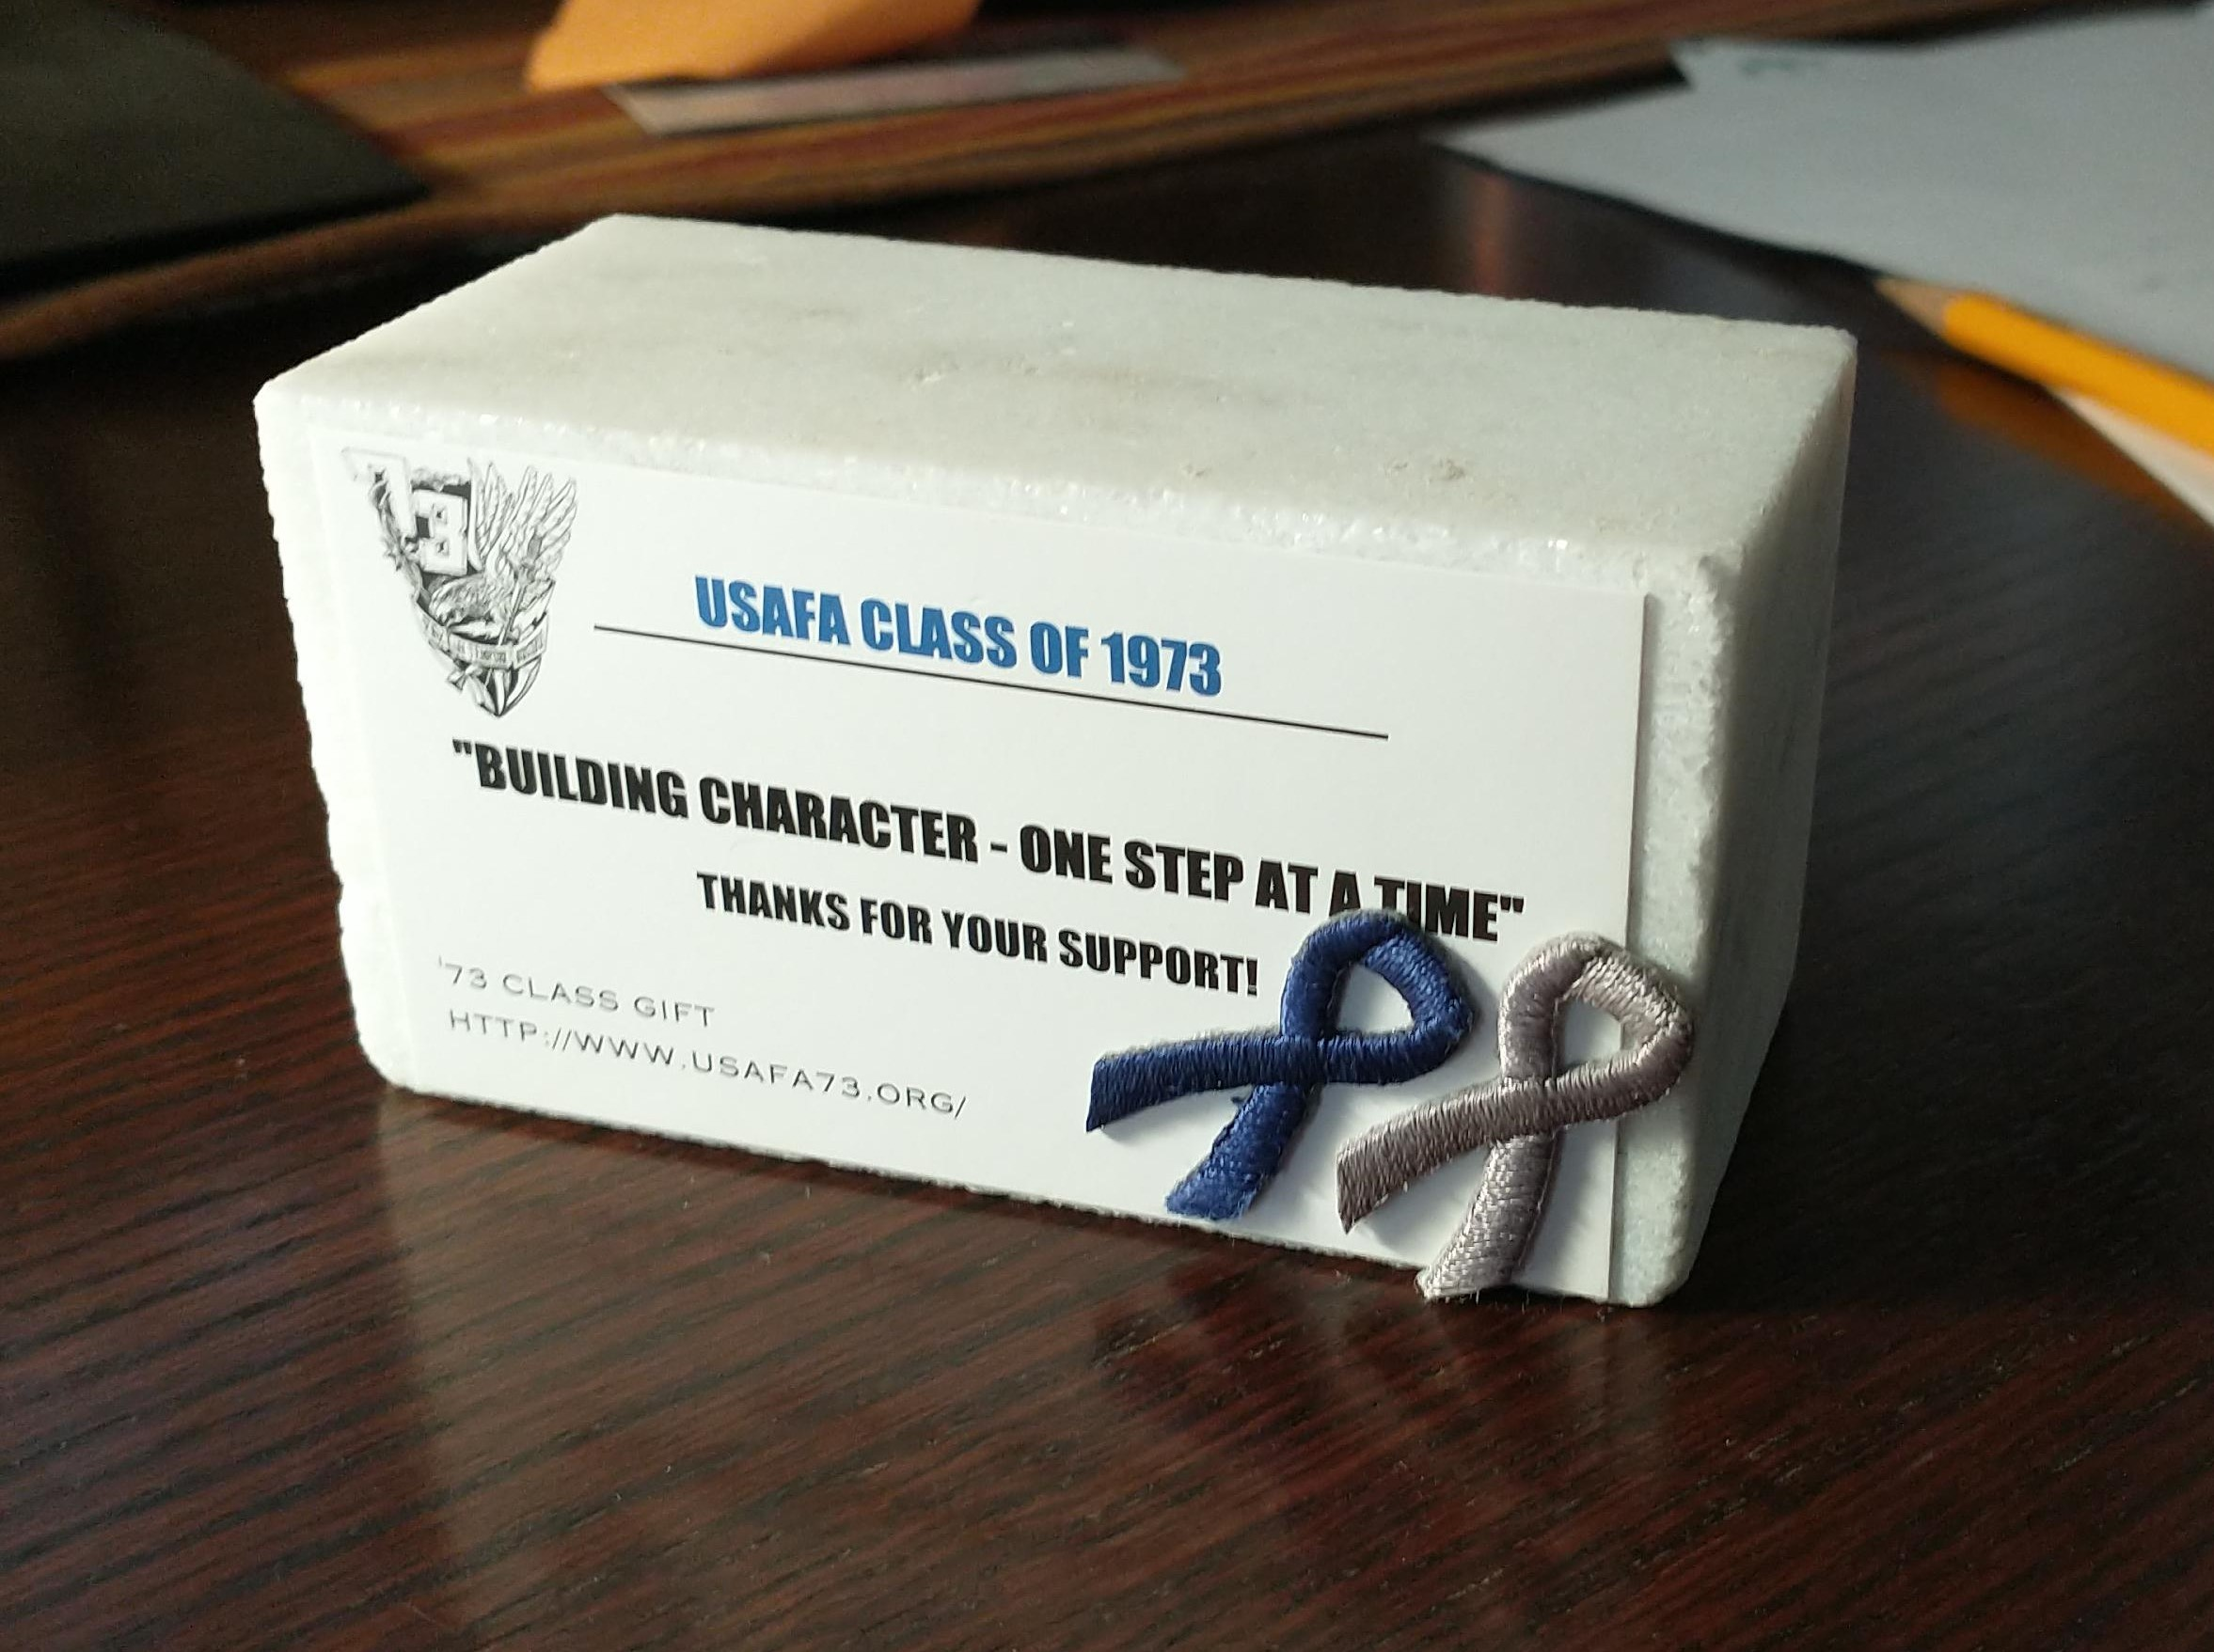
‘73 NCLS Status: Smash
NCLS Fund goal: $1.5M
Donated: $1.74M
Balance (EOY 22): $2.34M
Pledges: $1.5M
Impact:
21513 Grads have attended, most 4 times
NCLS now the Academy’s premier character program
Two full time staff, two Wing Staff positions
OUTCOMES:
Largest source of funds for NCLS
Endowment will last in perpetuity
Notes:
One in three Americans over the age of 65 have no will. One in six Americans over the age of 65 have a Will that is out of date.
Thus, only half of Americans over the age of 65 have up-to-date Wills in place.
Wealthy Americans are no more likely to have written their Will.
Wealthy Americans are more likely to have an out-of-date Will.

Slide 7
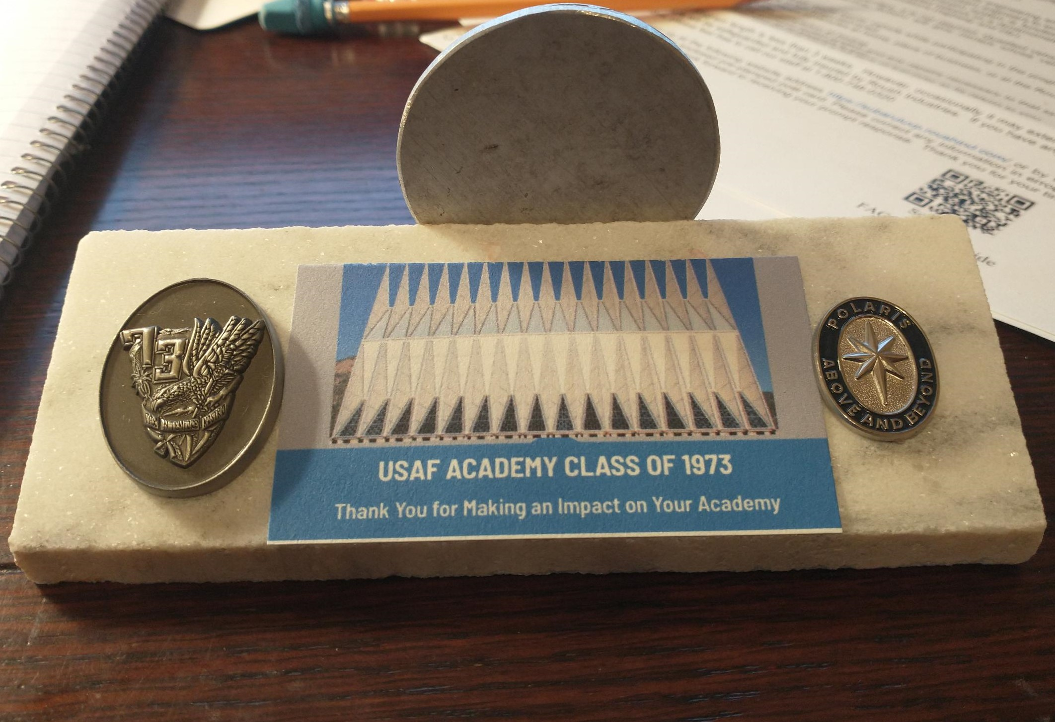
50th Reunion Class Gift Status
To date:
Do all of us have current wills?
2.25% Polaris Society….Fail
Total Pledges >$4.5M
’73 Long Blue Line Endowment Pledges: $3.3M
‘73 NCLS Pledges $1.245M
Notes:
One in three Americans over the age of 65 have no will. One in six Americans over the age of 65 have a Will that is out of date.
Thus, only half of Americans over the age of 65 have up-to-date Wills in place.
Wealthy Americans are no more likely to have written their Will.
Wealthy Americans are more likely to have an out-of-date Will.

Slide 8
Class Legacy Program
Ten Events over 4 Years: 2019 - 2023
January 2019 – Welcome
June 2019 – Swearing in Ceremony
July 2019 – Coin ceremony
August 2019 – Acceptance Day Parade
January 2020 – Forged in Blue
October 2020 – Exemplar Dinner (Grads only)
August 2021 – Commitment Dinner (Grads only)

Slide 9
Class Legacy Program, Con’t
May 2022 – Ring Dining Out and Dance
February 2023 – 100th Night (Grads only)
June 2023 – Commissioning Ceremonies
_______________________________________
Fall 2023 – Class of ‘73 50th Reunion
Funding in place -- current value: $44,143
Upgraded Contrails
Class coin
2nd Lt Bars
Class book
$8,000 for 2023 to use
Class-wide communication for participation

Slide 10
Class Policies
Class Operating Instructions
Established at our 35th
Amended at our 40th
Authority flows from the Class to the Officers to accomplish Class goals

Slide 11
Class Officer Election
President: Bill Diffley
Vice President: Jim Parker
Secretary: Kirk Samelson
Treasurer: Bob Munson
Class Scribe: Mike Arnett
Class Senator: AJ Ranft

